Slide 1
Experimental Results
All_IVCs Algorithm

Slide 2
Overhead of different algorithms
Algorithm | min | max | avg | stdev
IVC_MUST | 18.345% | 10169.231% | 1166.834% | 1590.774%
IVC_UC | 0.0% | 78.481% | 11.071% | 12.854%
IVC_UCBF | 23.033% | 9738.860% | 1048.532% | 1419.658%
* Overhead = (running time of the algorithm)/ (JKind verification time) * 100

Slide 3
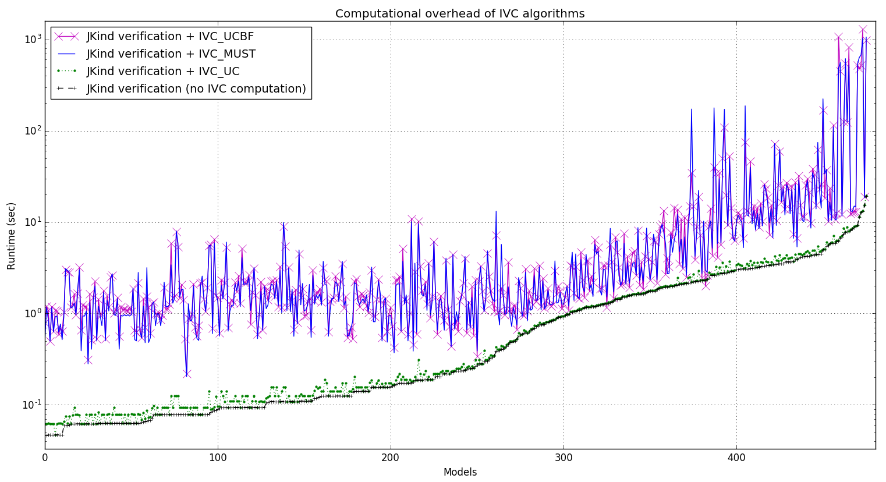

Slide 4
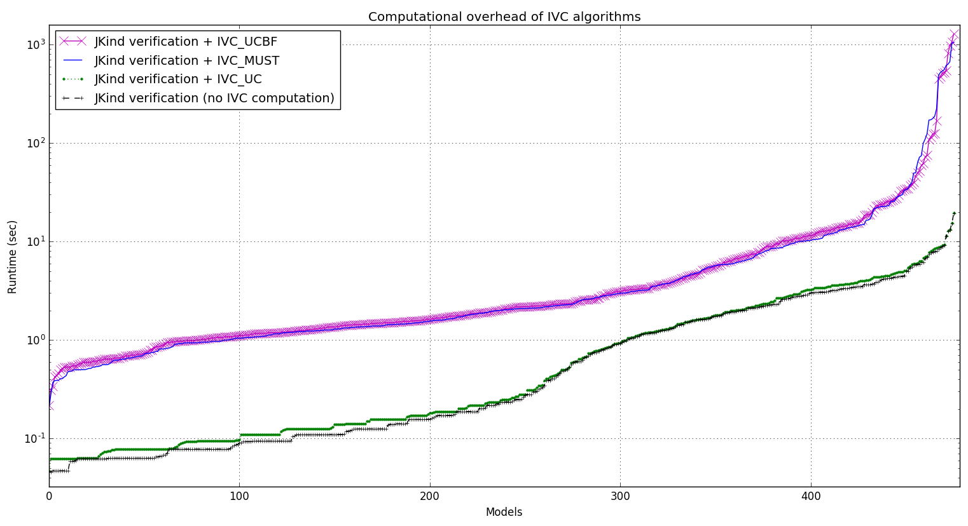

Slide 5
Running time of different algorithms
Running time (sec) | min | max | avg | stdev
IVC_UC + proof time | 0.047 | 19.537 | 1.414 | 2.291
IVC_UCBF + proof time | 0.219 | 1286.479 | 20.776 | 108.626
IVC_MUST + prooftime | 0.203 | 1058.299 | 20.393 | 98.255
Proof time | 0.046 | 19.287 | 1.331 | 2.195

Slide 6
Coverage of different algorithms
IVC sizes | min | max | avg | stdev
IVC_UC | 1 | 141 | 12.720 | 15.991
IVC_UCBF | 1 | 129 | 11.670 | 15.057
IVC_MUST | 1 | 129 | 11.649 | 15.029
Ratio of IVC sizes | min | max | avg | stdev
IVC_UC to IVC_UCBF | 1.0 | 8.25 | 1.179 | 0.450
IVC_MUST to IVC_UCBF | 0.5 | 4.0 | 1.005 | 0.196
IVC_UC to IVC_MUST | 1.0 | 8.25 | 1.188 | 0.456

Slide 7
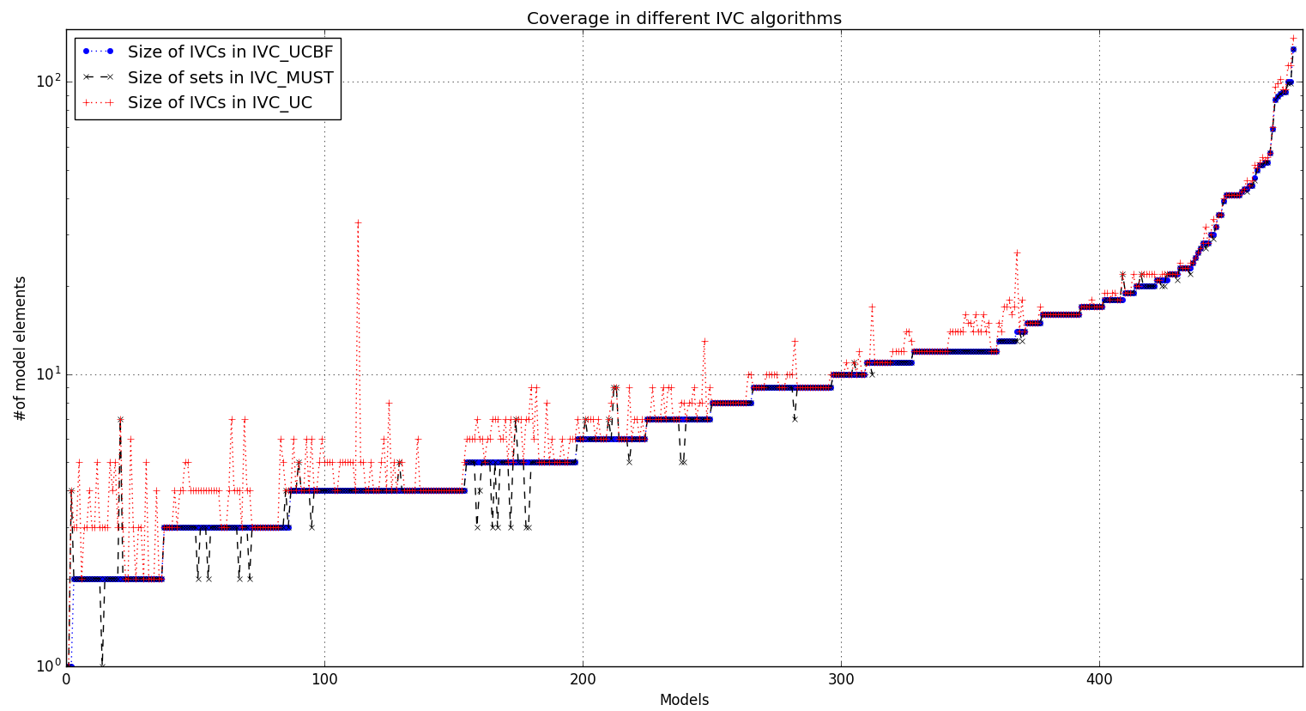

Slide 8
Info on IVC_MUST minimization runs
Running time (sec) | avg | stdev
All runs among all models | 0.88 | 7.83
VALID runs among all models | 2.07 | 2.69
INVALID runs among all models | 0.17 | 0.41
UNKNOWN runs among all models | 115.52 | 0.49
Info on IVC_UCBF minimization runs
Running time (sec) | avg | stdev
All runs among all models | 0.89 | 7.88
VALID runs among all models | 2.55 | 0.44
INVALID runs among all models | 0.21 | 0.92
UNKNOWN runs among all models | 126.91 | 0.81

Slide 9
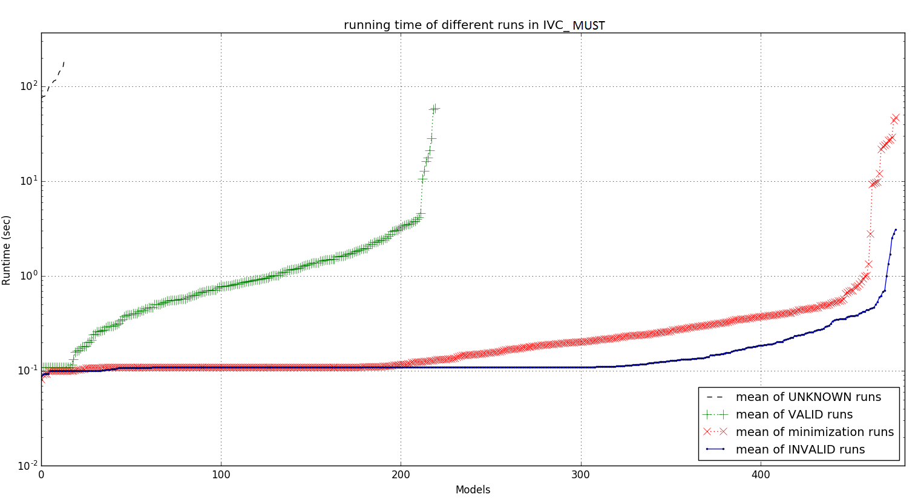

Slide 10
